Slide 1

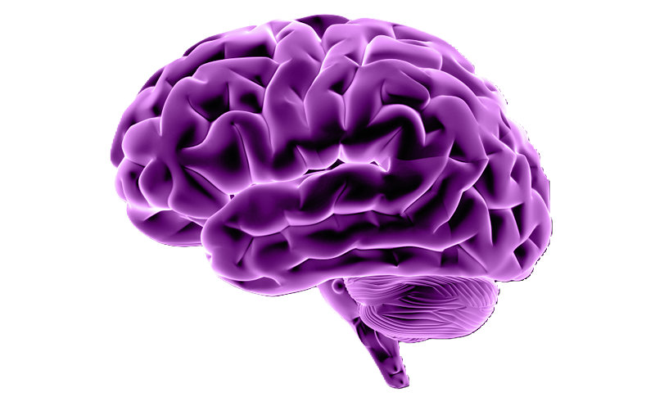

GRAPH-BASED MANIFOLD LEARNING FOR MOTOR IMAGERY CLASSIFICATION USING EEG SIGNALS
CPG -160
Mentor Name: Anurag Tiwari
Vanshika Mittal
Ishita Suchdeva
Selina Varshney
Vanshika Narang
Aarushi Kamboj
102103484
CO18
102103493
CO18
102103496
CO18
102103510
CO18
102103237
3CO9

Slide 2


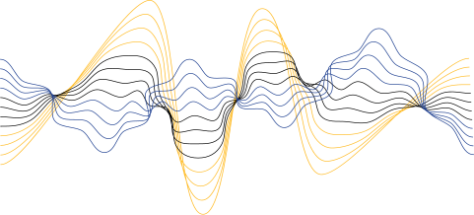

PROBLEM DEFINITION
PROJECT
SCOPE
Our project aims to empower individuals facing motor impairments and paralysis by interpreting their EEG brain signals using three powerful techniques: Graph Neural Networks (GNN), Bidirectional Long Short-Term Memory (BILSTM), and Deep Belief Attention Network (DBAN).
Enhance EEG signal classification for motor imagery using advanced neural networks.
Capture spatial-temporal patterns with GNN and Bi-LSTM.
Develop a user-friendly system for EEG-based motor imagery applications.

Slide 3
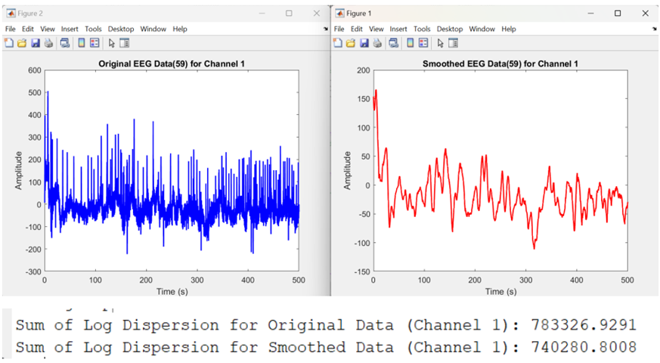
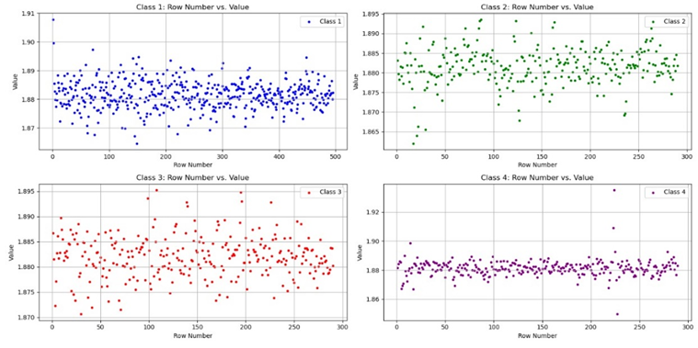
APPROVED OBJECTIVES
1. Data Acquisition
2. Data Preprocessing:
Handling missing value, baseline correction,
filtering, Sgolay filtering,
normalization, standardization
Log Dispersion After Data Preprocessing
3. Spatial-Temporal Feature Extraction
Spatial Neural Network Design:
Residual Connections
Dilated Convolution
Multi-Resolution Pathways
Temporal Neural Network Design
LSTM with Skip Connections
Attention Mechanisms
Spatial Feature Extraction for 22 Channels
Residual LSTM Blocks

Slide 4

LITERATURE SURVEY
MAST-GCN: Multi-Scale Adaptive Spatial-Temporal Graph Convolutional Network for EEG-Based Depression Recognition
Adaptive Spatiotemporal Graph Convolutional Networks for Motor Imagery Classification
01
02
The study proposes an Adaptive Spatiotemporal Graph Convolutional Network (ASTGCN), with 10-fold cross validation for MI-EEG classification, which unlike traditional GCNs, adaptively assesses node importance and extracts time-domain features to enhance classification performance.
ASTGCN achieves an average accuracy of 90.6%.
The study highlights MAST-GCN framework, using Adaptive Graph Convolution for dynamic topologies, Multi-Scale Time Convolution for diverse time-domain features, and 3D Graph Convolution for integrating spatial-temporal information, outperforms RNN, CNN, and other traditional techniques achieving 80.13% accuracy , 76.48% F-Score, and 77.94% sensitivity with a good balance.
.

Slide 5
Dynamic Multi-Graph Convolution-Based
Channel-Weighted Transformer Feature Fusion Network for Epileptic Seizure Prediction
Constructing Time-Varying Directed EEG Network by Multivariate Nonparametric Dynamical Granger Causality
03
04
The study proposes a Spatio-Temporal Graph mndGC outperforms ADTF in noise resistance and capturing instantaneous directed network changes in EEG data. mndGC reveals distinguishable network characteristics between left- and right-hand motor imagery (MI) during different MI stages.
The study extends nonparametric causality exploration and provides practical suggestions for time-varying directed EEG network analysis.
The study proposes the MB-dMGC-CWTFFNet, a deep learning framework designed to predict epileptic seizures using EEG data.
The framework achieves outstanding accuracies on two datasets: an AUC of 0.935 on the CHB-MIT dataset and 0.984 on the Xuanwu dataset, with corresponding sensitivities of 97.8% and 100%, and low false prediction rates per hour of 0.059 and 0.079, respectively.

Slide 6

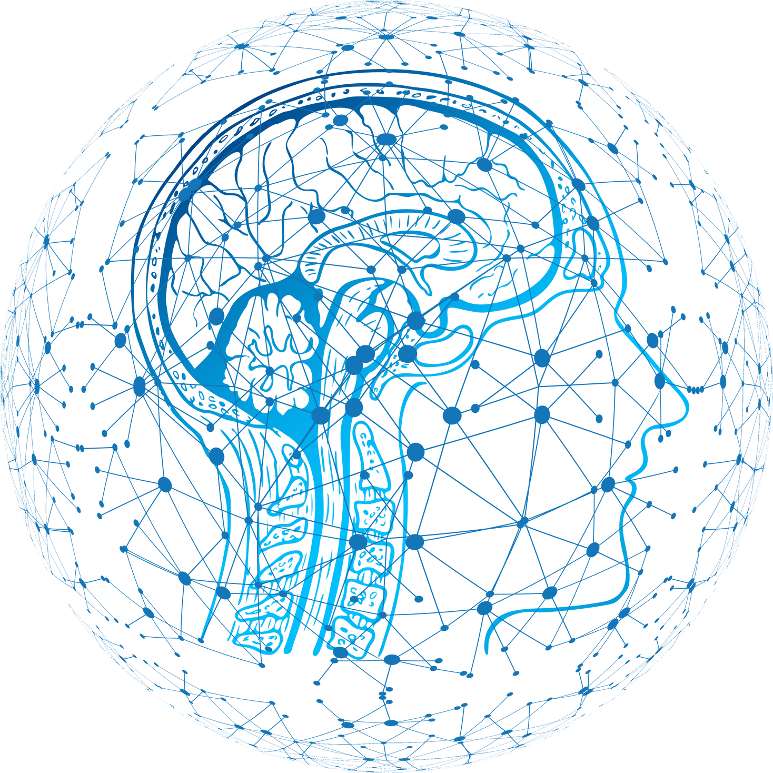

TOOLS/PLATFORM USED
Data Collection and Preprocessing:
Data Acquisition: Public EEG datasets (e.g., BCI Competition), files stored in Excel/CSV.
Data Cleaning: MATLAB for smoothing, baseline correction, filtering, and normalization.
Model Development:
GNN Module: TensorFlow, Keras, PyTorch, DGL, and NetworkX for graph-based models.
BI-LSTM Module: TensorFlow, Keras, PyTorch for sequence processing.
DBAN Module: TensorFlow, Keras, PyTorch for deep belief networks and attention mechanisms.
Testing and Validation:
Testing: unittest/pytest for testing, TensorBoard for visualization.
Validation: Scikit-learn for performance metrics, confusion matrix visualization.
Collaboration:
Version Control: Git/GitHub.
Documentation: Google Docs, Markdown.

Slide 7
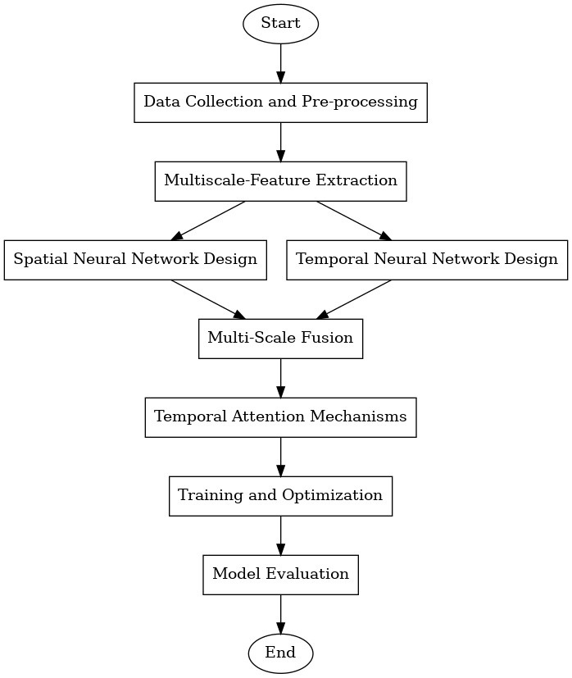
DETAILED DESIGN

Slide 8
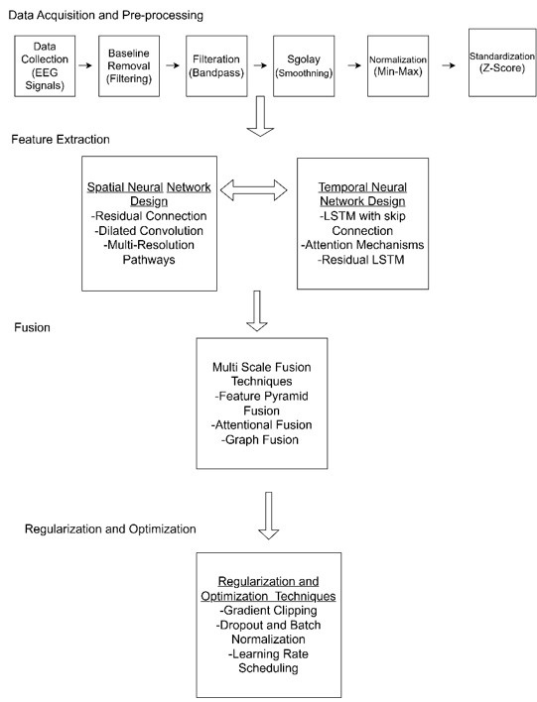
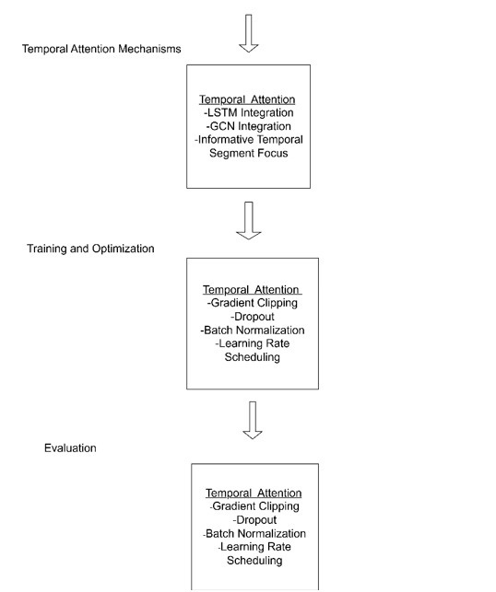

Slide 9

CONTRIBUTIONS OF INDIVIDUAL TEAM MEMBERS
59 CHANNELS
22 CHANNELS
118 CHANNELS
Vanshika Mittal
Aarushi Kamboj
Selina Varshney
Vanshika Narang
Ishita Suchdeva

Slide 10
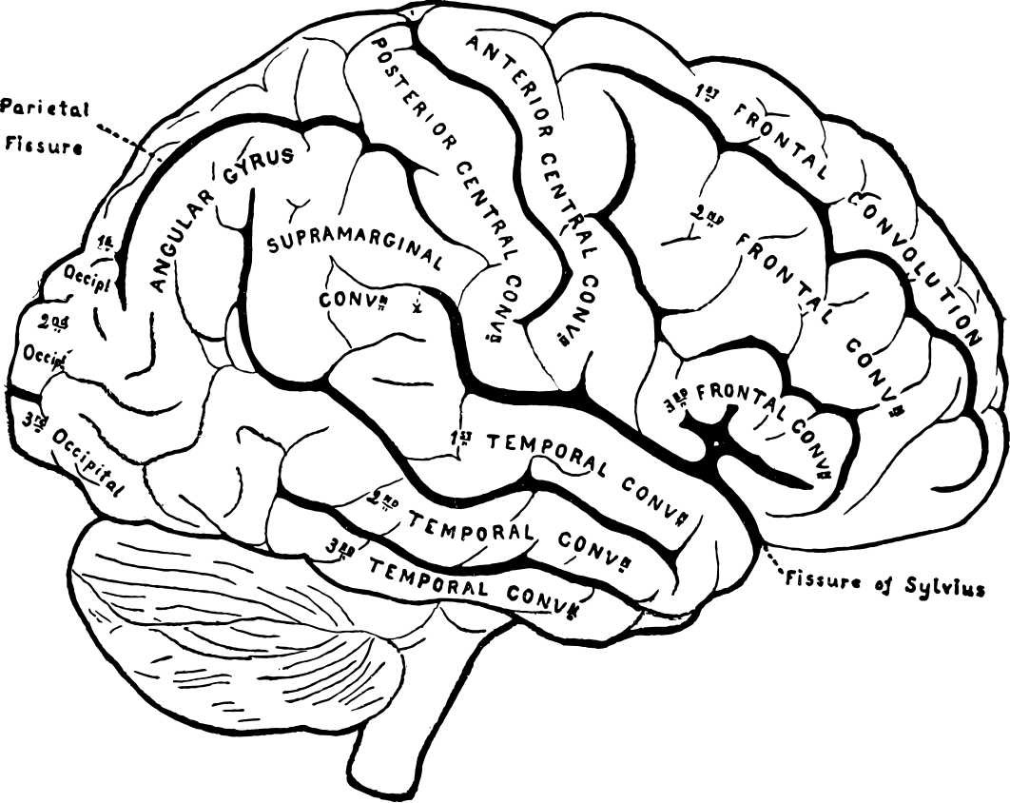

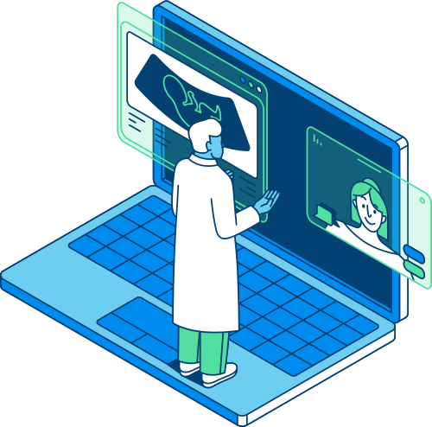
Project Outcomes
· The classification framework will be capable of accurately identifying and classifying different motor imagery tasks from EEG signals.
· A software design or prototype implementing the classification framework will be produced, providing a user-friendly interface.
· The project will involve the development of new algorithms, techniques, and methodology for processing EEG signals. These algorithms will be novel adaptations and extensions of existing methods to increase accuracy, efficiency, and interpretability.

Slide 11
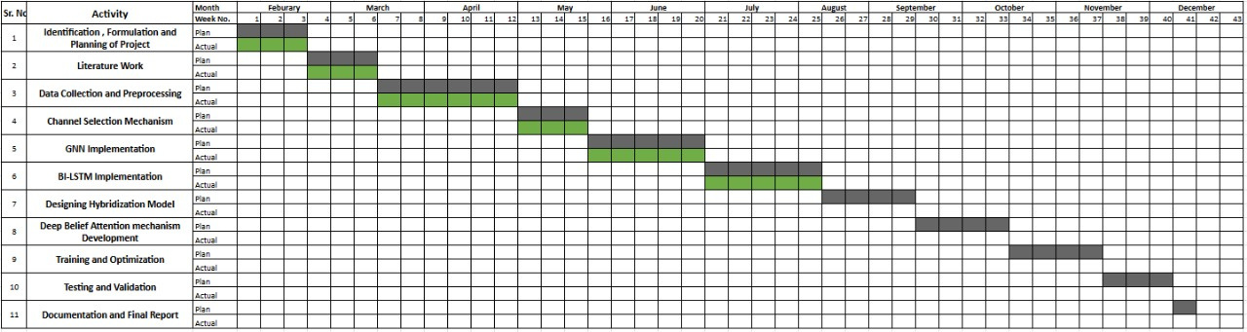
Work Progress

Slide 12
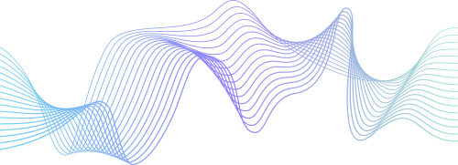
Future Plan
Multi-Scale Fusion:
Feature Pyramid Fusion
Attentional Fusion
Graph Fusion
Regularization and Optimization:
Gradient Clipping
Dropout and Batch Normalization
Learning Rate Scheduling
Training and Optimization:
Interpretability with
Grad-CAM
Evaluation
Temporal Attention Mechanisms:
Model Architecture

Slide 13


Slide 14


Problem Satement
Individuals with paralysis or severe motor impairments struggle to interact, communicate, and perform daily tasks independently.
Empowering them requires an assistive technology capable of decoding their brain signals to enable movement in the targeted body part.
OBJECTIVES
1
Develop a Multimodal Deep Learning Framework
2
Enhance Decoding Accuracy
3
1
Evaluate Generalization and Transfer Learning
Investigate Feature Learning and Representation
4
Validate Against Existing Methods
5
1
1

Slide 16



Assumptions
EEG Signal Quality
Transferability of Knowledges
Stationarity of EEG Signals
Model Scalability
Independence of Modalities
Constraints
Limited Data Availability and Quality
Model Complexity and Interpretability
Computational Resources
Ethical and Regulatory Considerations
Generalization Across Subjects and Tasks
Integration with Existing Systems
Time and Resource Constraints

Slide 17
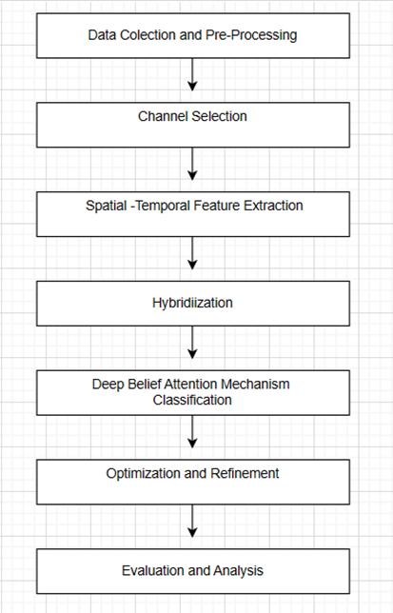
Methodology
THE METHODOLOGY INVOLVES COLLECTING EEG DATA FROM BCI INTERFACES, PREPROCESSING IT AND APPLYING FILTERING TECHNIQUES.
NEXT, CHANNEL SELECTION IS PERFORMED USING FILTER AND WRAPPER METHODS.
SPATIAL-TEMPORAL FEATURES ARE EXTRACTED USING GRAPH NEURAL NETWORKS (GNN) AND BI-DIRECTIONAL LONG SHORT-TERM MEMORY (BI-LSTM) NETWORKS.
THE HYBRIDIZATION OF THESE FEATURES IS THEN UTILIZED FOR CLASSIFICATION USING DEEP BELIEF ATTENTION NETWORKS (DBAN).
THIS IS FOLLOWED BY EVALUATION, OPTIMIZATION, AND DOCUMENTATION OF THE RESULTS.

Slide 18
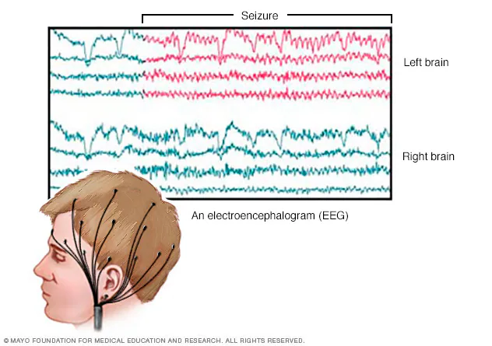
Project Requirements
Programming
Visualization tool
Python
Matlab
Matplotlib
Seaborn
Signal Processssing Tool
Deep Learning
Fameworks
Data Science Library
GNN
Libraries
MNE
EEG Lab
Tensorflow
Pytorch
NumPy
Pandas
SciPy
PyG
DGl

Slide 19
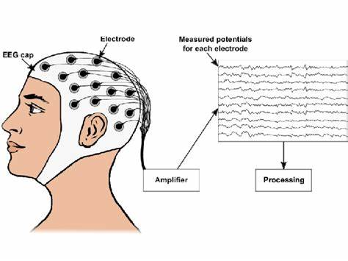

Project Outcomes
Accurately classify motor imagery tasks from EEG signals
Develop user-friendly software implementing the classification framework.
Create new algorithms for processing EEG signals, enhancing accuracy and efficiency.

Slide 20
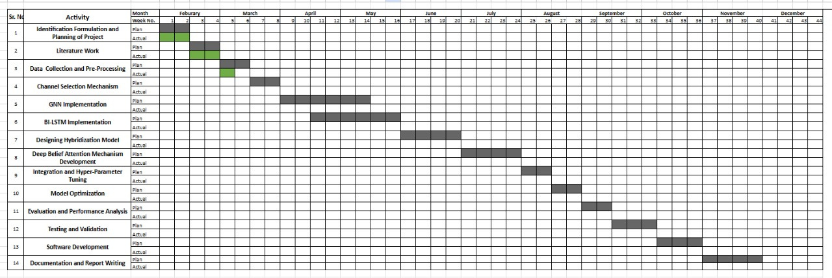

Work Plan

Slide 21
Future Plan

Slide 22

Role Contribution of Individual Team Member
Ishita Suchdeval
Vanshika Narang
Overview
Novelty
Assumptions & Constraints
Objectives
Methodology
WorkPlan
Outcomes
Vanshika Mittal l
Selina Varshney
Aarushi Kamboj
Problem
Statement &
Need Analysis
Objectives
Literature Survey
Methodology
WorkPlan
Outcomes

Slide 23
THANK
YOU

